Slide 1
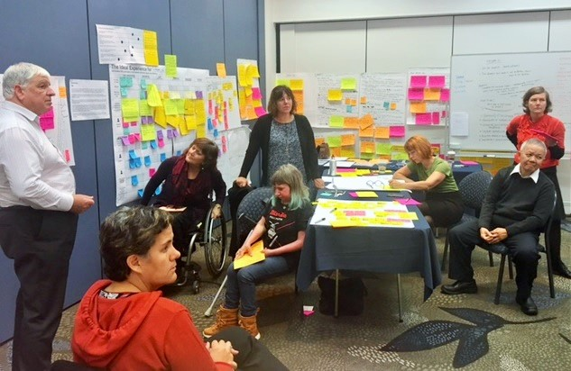
System Transformation
The transformation of New Zealand’s disability support system
Prepared for the Japanese Young Core Leaders Programme
October 2017

Slide 2
Overview
Enabling Good Lives (case for change)
Co-design process: how it worked
High-level design
Next steps

Slide 3
Case for change
Disabled people wanting greater choice and control
System - one size fits all
Government funding fragmented
Rising costs - $1.2 billion
Poorer outcomes

Slide 4
Enabling Good Lives
Vision
Principles
Self determination
Beginning early
Person-centred
Ordinary life outcomes
Mainstream first
Mana (self esteem) enhancing
Easy to use
Relationship building
2013 - Two demonstrations

Slide 5
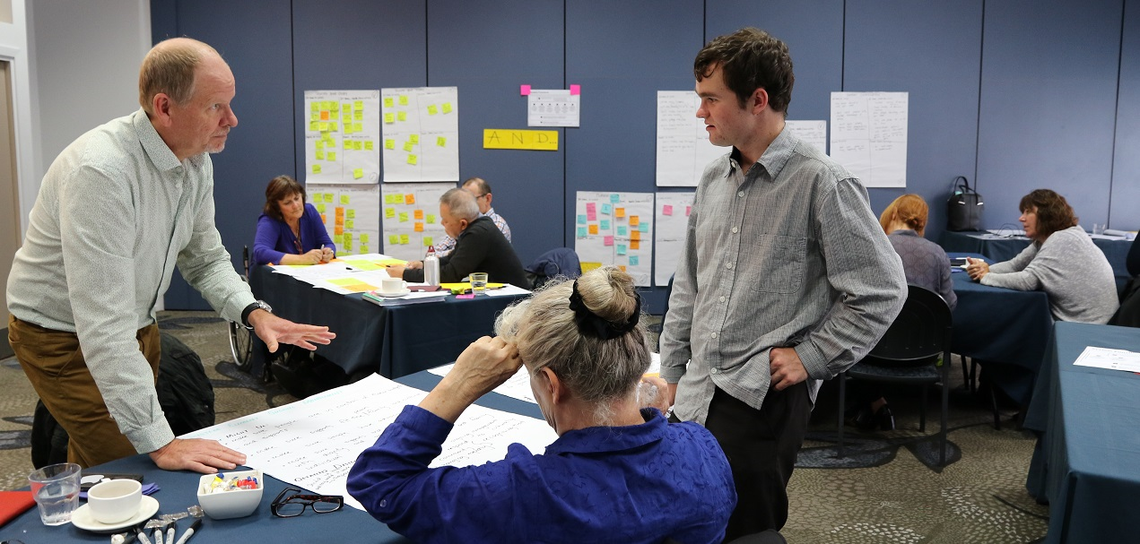
Co-design: how it worked
Co-design group -
Five disabled people
Two representatives with disabled family members
Two from disability service organisations
Four officials

Slide 6
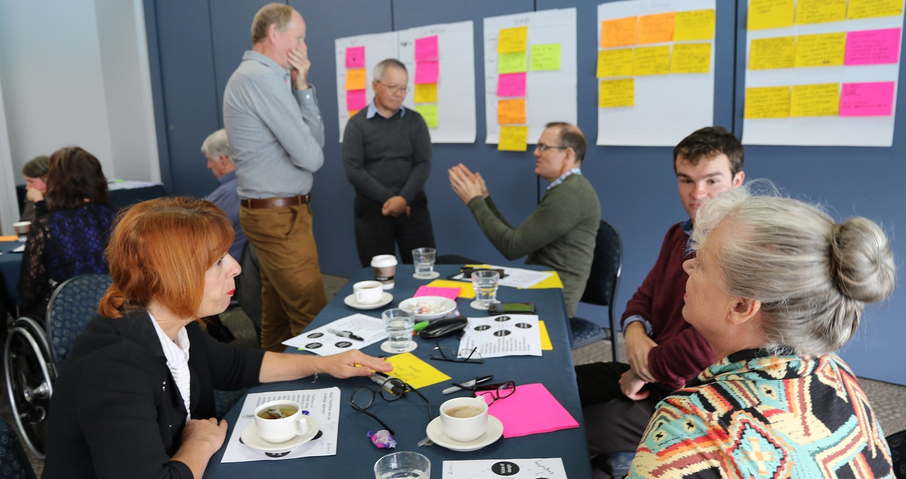
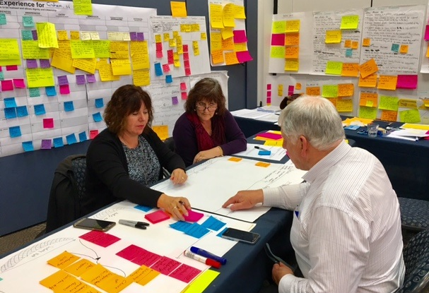
Guidelines
Based on EGL vision & principles
Learn from trials and evidence
Social investment approach
Transform system, not add layers
Cross-government disability support
Capped funding

Slide 7
High-level design
Disability Information hub and Outreach
Disabled people and whānau (family) capability building
New funding model
Expanded peer and whānau (family) networks
includes support for people with only paid people in their lives
Personal information profile and tool
Reduced monitoring
Depends on level of funding
National and local governance groups
with disabled people/whānau (family) taking part

Slide 8
Why MidCentral?
People use Disability Support Services
1,600
20%
Mix
No trials
Change
Māori population
City and rural
No previous trials
Ready to change

Slide 9
Detailed design
Continuing co-design
20+ working groups
1/3 disabled people
Virtual testing groups
Disability community inputs
Governance group

Slide 10
More information http://www.enablinggoodlives.co.nz/

