Slide 1
The promotion and maintenance of NZSL
October 2017

Slide 2
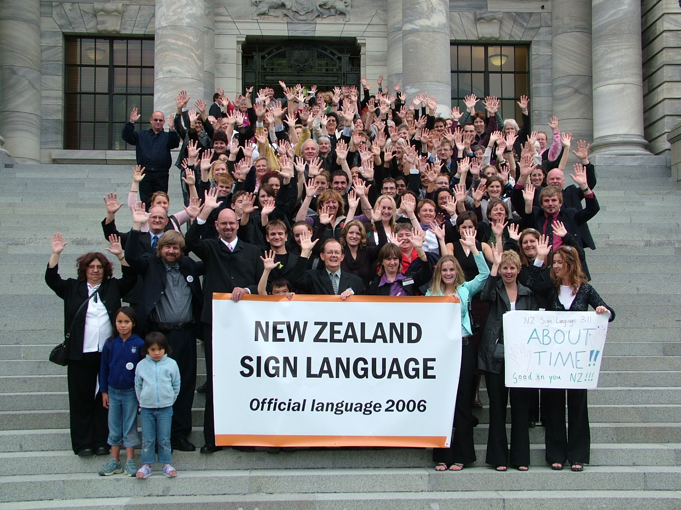
‘Minority’ languages
A language with strong vitality (survival prospects) is used:
by many people
in the home and in many other domains
to talk about most, if not all, topics
by all generations (children!)

Slide 3
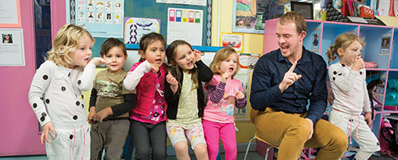
Language Vitality KOREAN PLEASE
by many people
In home/many other domains
By all generations (children!)

Slide 4
Human Rights Commission Inquiry

Slide 5
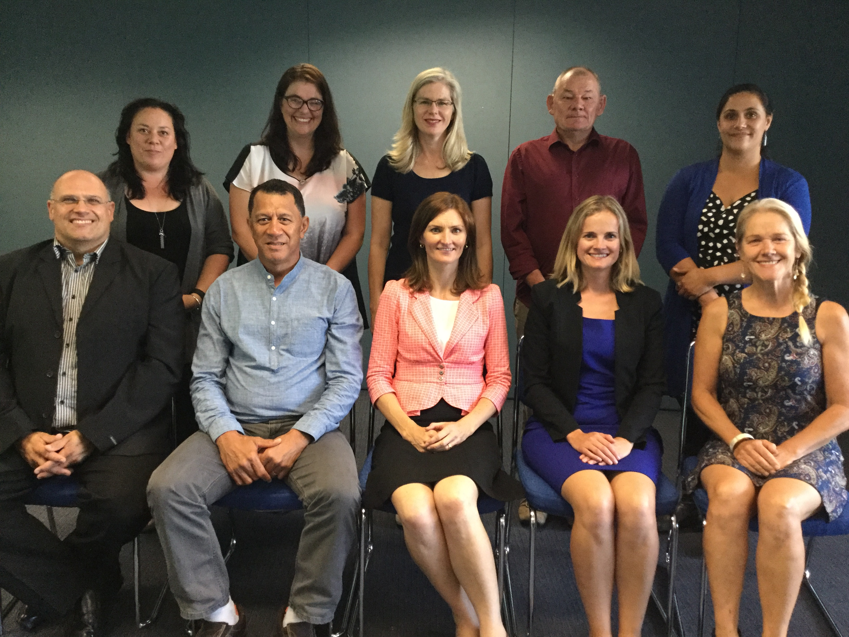

Slide 6
NZSL?

Slide 7
Language planning and policy

Slide 8
Focus areas for language planning
Use/Access
Status
Documentation
Awareness
Acquisition

Slide 9
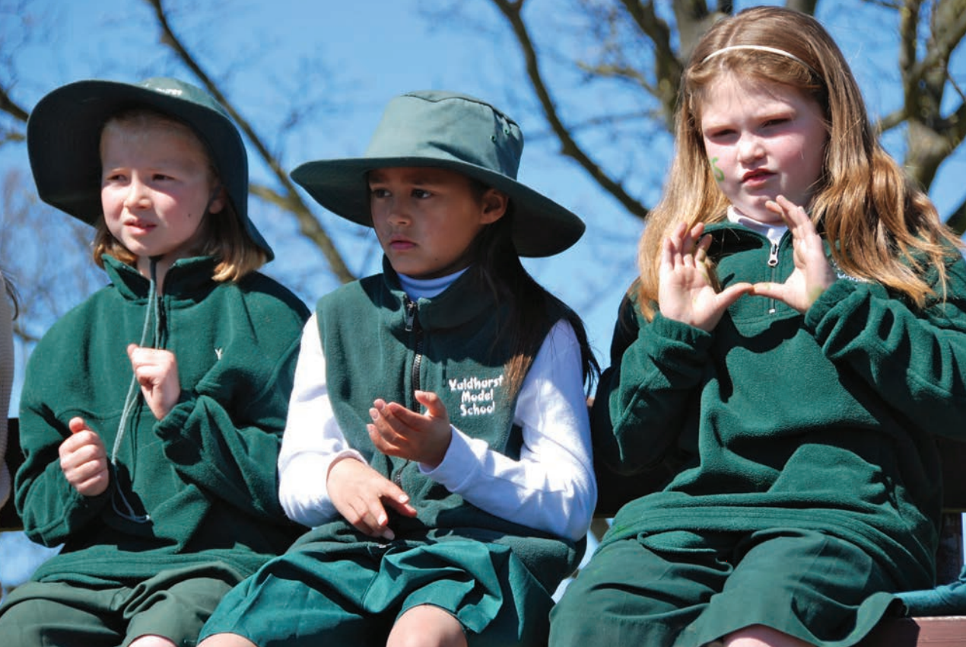
Children: 1st language,
full proficiency
Acquisition

Slide 10
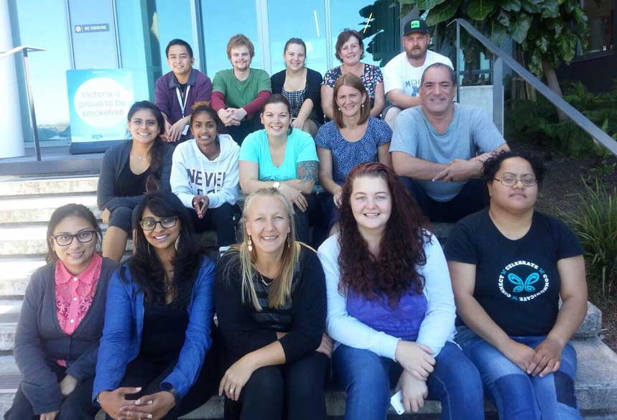
Adults: 2nd language learning
Acquisition

Slide 11
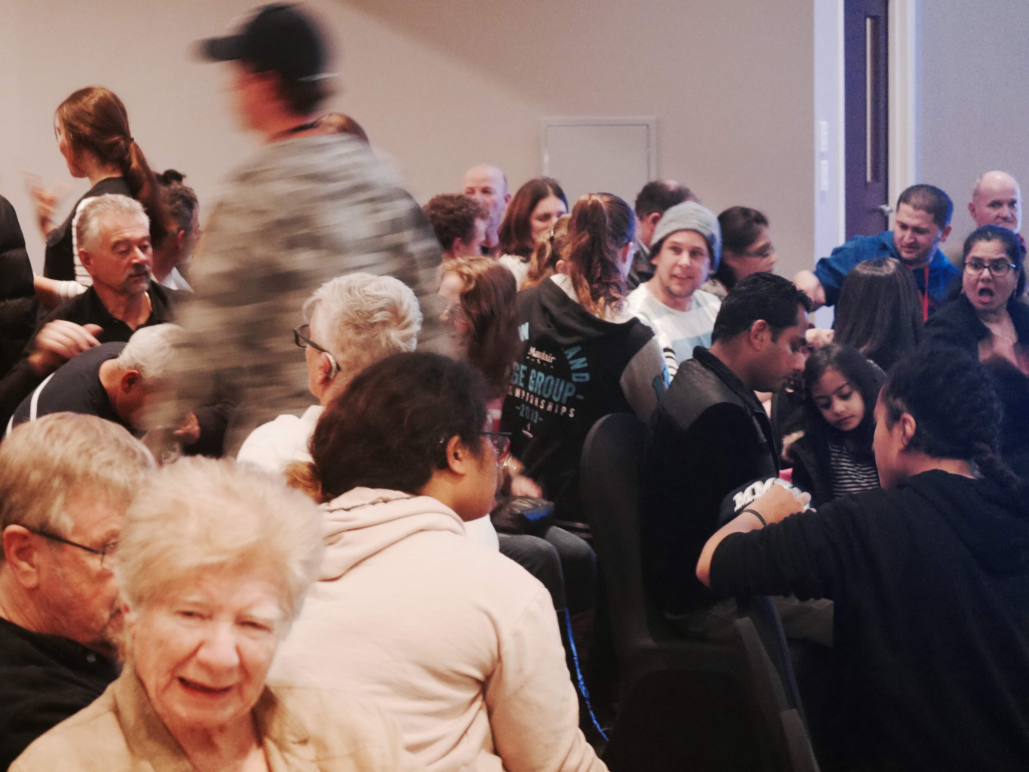
Use of NZSL in all domains
Social equality = access to information/services
Use/Access

Slide 12
Status
Recognition: Law, policy, rights
Planning: Actions, resources, monitoring

Slide 13
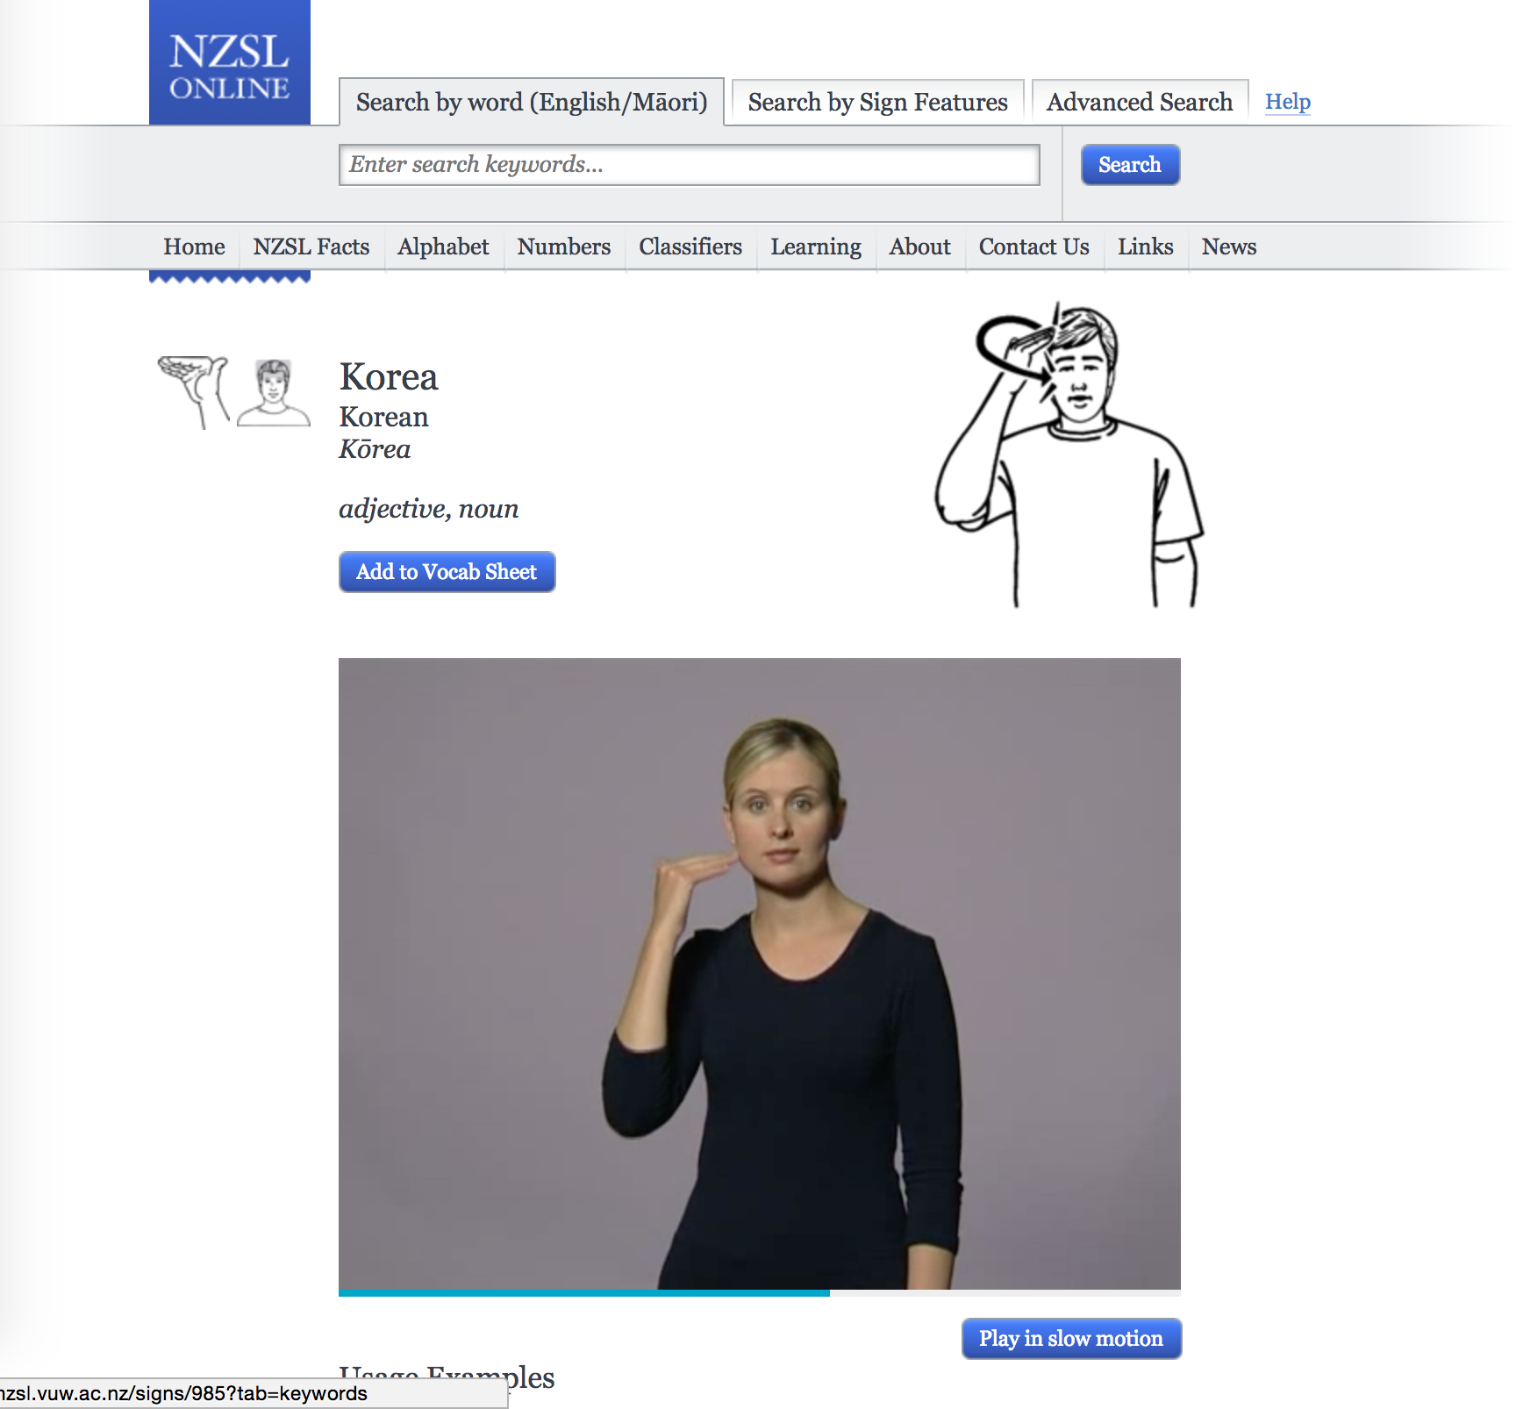
Dictionary, grammar, research, archives
Teaching & learning materials
Documentation

Slide 14
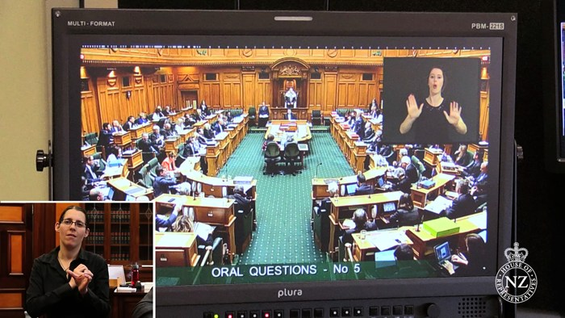
Awareness & tolerance of language
Value & visibility of language
Awareness

Slide 15
What do you already know?
?

